Slide 1
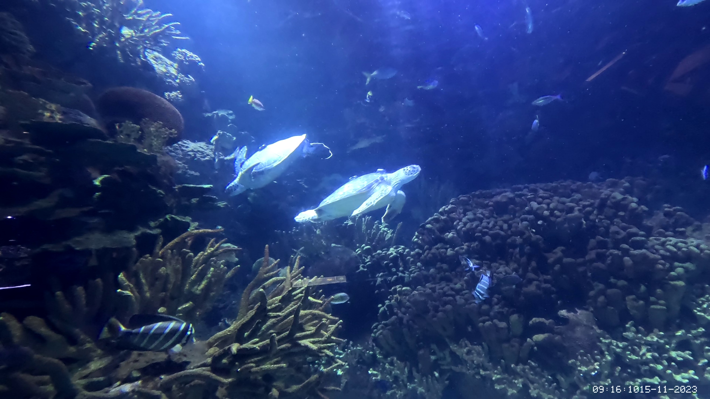
Using accelerometers to study animal behaviour
Dr. Jessica Harvey-Carroll
Jessica.carroll@bioenv.gu.se

Slide 2
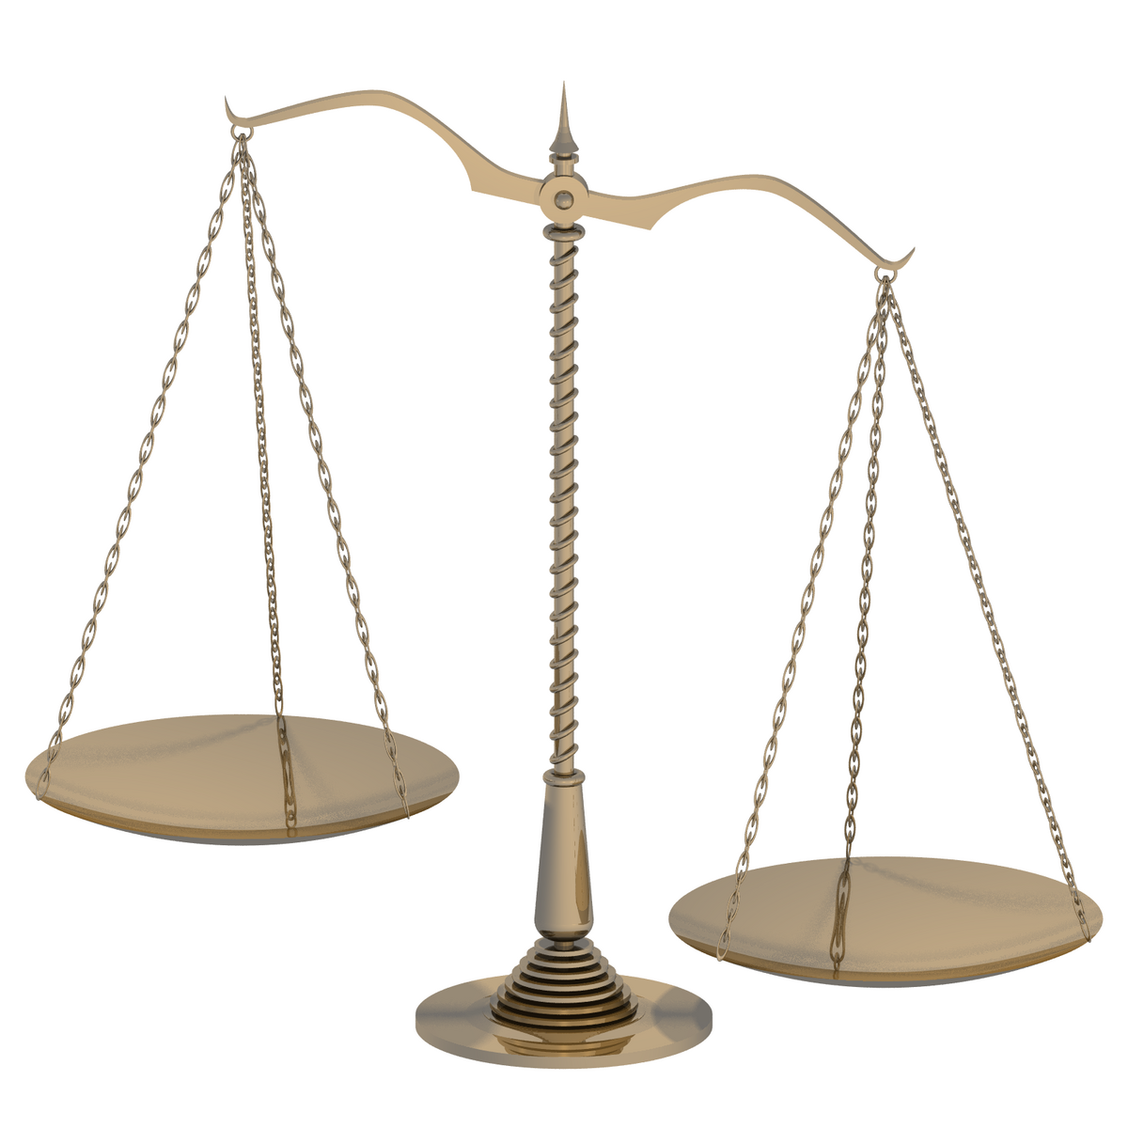
Biologging trade-off’s
Resolution
Battery & memory
Deployment duration (frequency of handling)
Attachment methods
Animal welfare

Slide 3
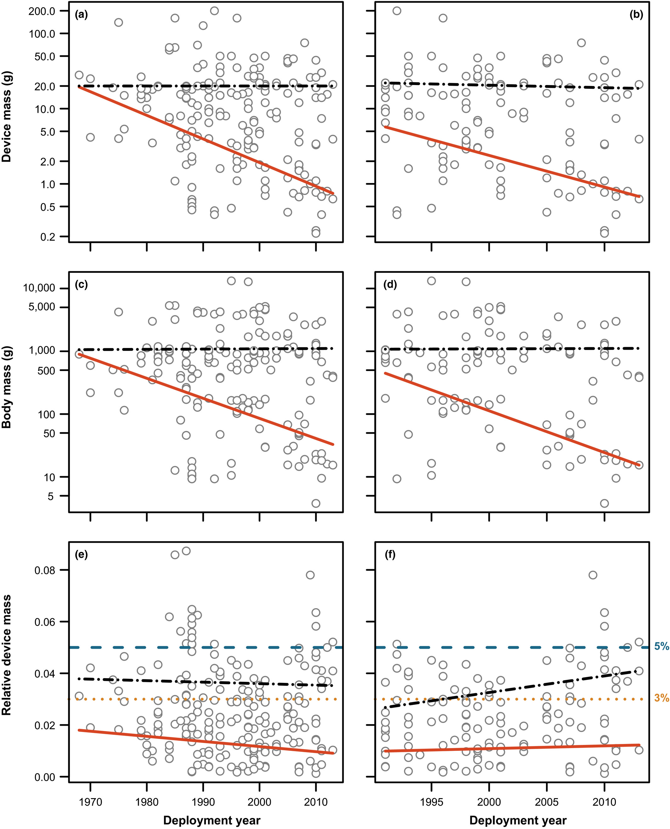
Any interaction with animals has negative effects.
Guidance for device mass (3%)
Size shape considerations
Internal vs external attachment
Portugal and White 2018

Slide 4
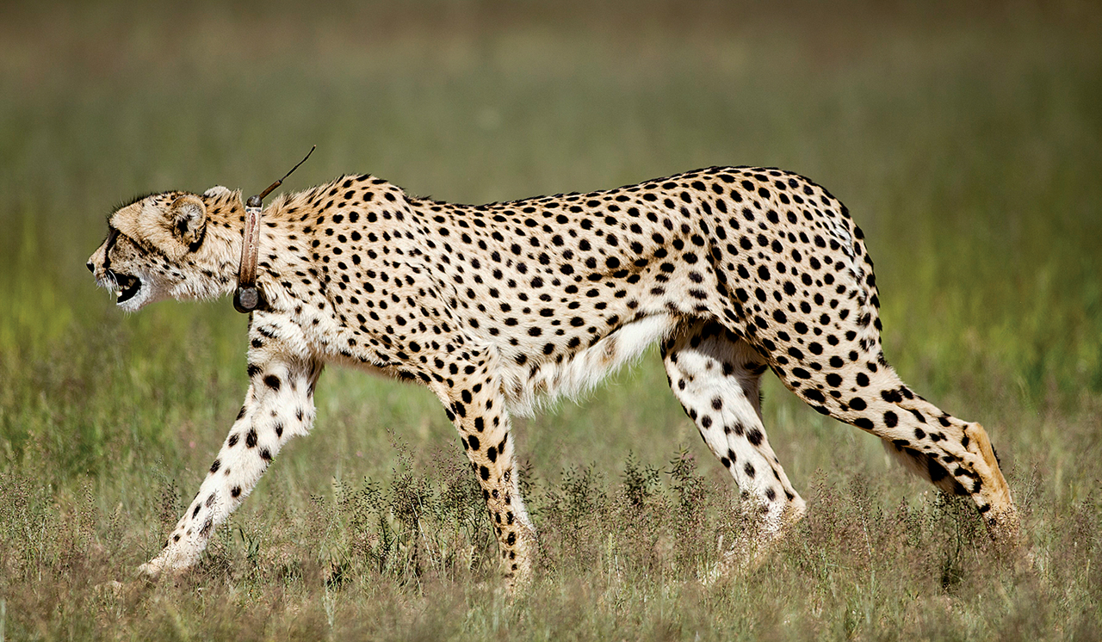
Mass of device
3% increasingly arbitrary
Devices below 3% of a hunting cheetah’s (Acinonyx jubatus) mass exerted forces up to 54% of the cheetah’s weight during hunting
(Mcintyre 2015; Wilson et al. 2021)
Notes:
PHOTO: © RICHARD DU TOIT/CORBIS

Slide 5
Attachment
Attachment type. | Example taxa. | Limitation(s).
Ringing (e.g., leg or wing ringing). | Most birds. | May cause injury. Can increase drag during flight.
Ear tag. | Terrestrial mammals. | Can easily be lost, not suitable for large biologging devices.
Flipper tag. | Pinnipeds and chelonians. | Can increase the risk of entanglement.
Collar. | Terrestrial mammals. | Only suitable for large animals.
Adhesive (e.g., two component epoxy, super/ hot glue, Tesa tape). | Chelonians, birds, pinnipeds, Erinaceidae. | Falls off when fur or feathers are shed. Physically removed in the case of Erinaceidae. Can increase swimming drag.
Bolt. | Pangolins, chelonians, sharks. | Requires a hard structure. Risk of structural damage.
Internal (e.g., surgically inserted PIT tag). | A broad range of marine and terrestrial animals. | Invasive surgical procedure. Poorly researched impact on welfare.
Harness. | Birds, chelonians, pinnipeds. | Can cause irritation and injury particularly for growing animals.
Harvey-Carroll et al., 2025

Slide 6
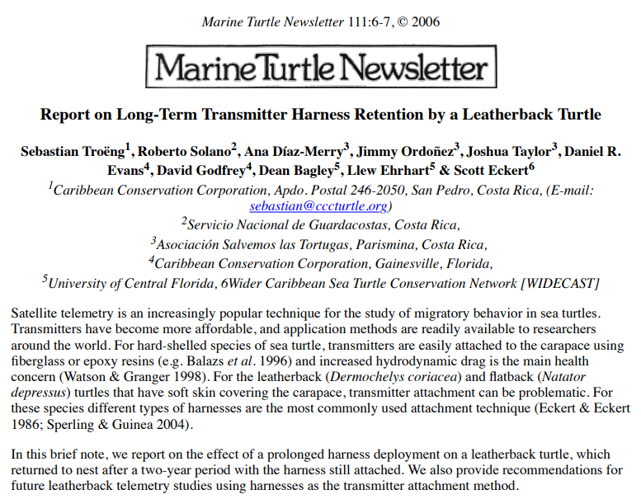
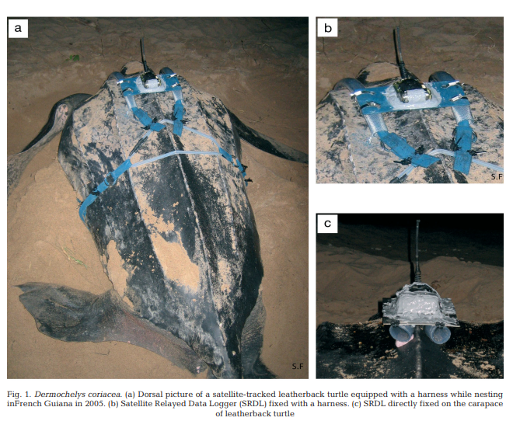
Ethical attachments?
Fossette et al., 2008
Troeng et al., 2006

Slide 7
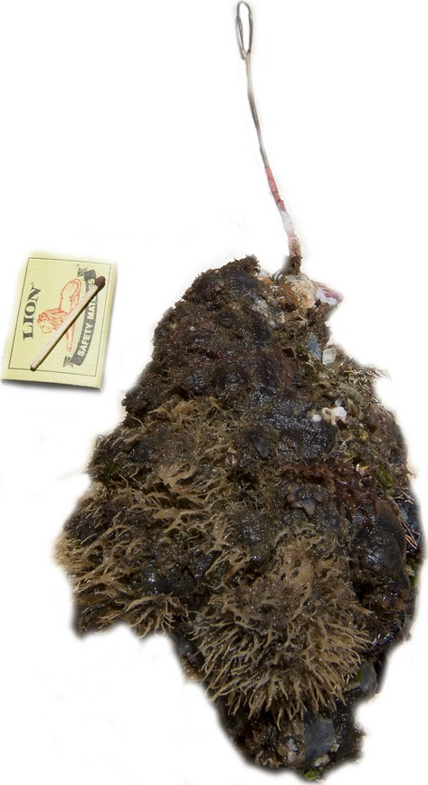
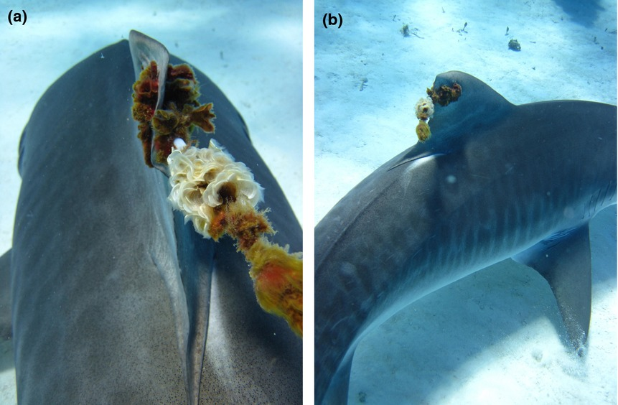
Obvious down sides...
“Tiger shark (Galeocerdo cuvier) with a satellite tag photographed by an ecoutourist at a popular shark dive tourism site in the Bahamas. (a) The antenna is highly biofouled beyond in situ cleaning and (b) the tag has rotated in the fin such that the antenna will not sufficiently be able to break the water's surface and transmit to an orbiting satellite. Images courtesy Sean Williams.” (Hammerschlag et al., 2014)
“Biofouled acoustic tag physically removed from a white shark (Carcharodon carcharias) by a dive ecotour operator. The shark had a fresh minor abrasion at the contact point of the tag on the shark's skin. The recovered tag weighed 800 grams due to the growth. Matchbox included for scale. Image and information courtesy Chris Fallows.” (Hammerschlag et al., 2014)

Slide 8
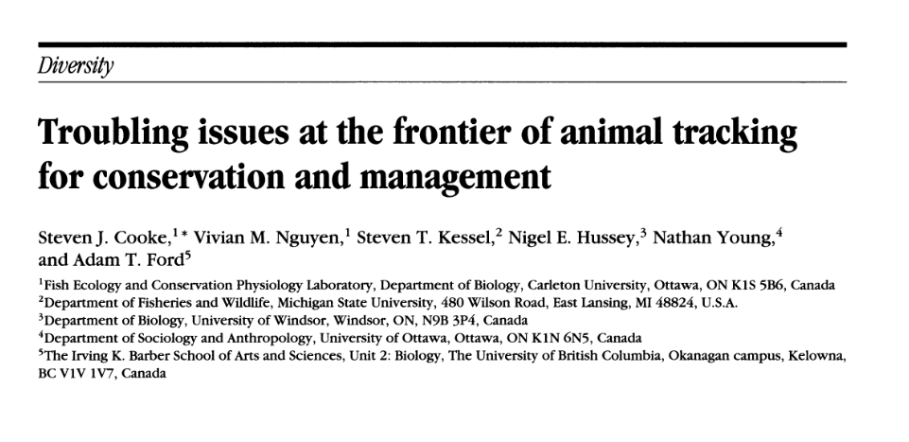

Slide 9
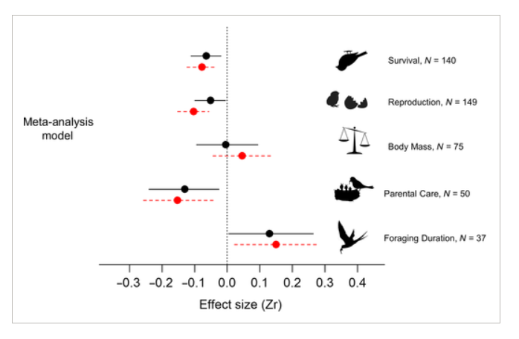
The less obvious downside...
Increased mortality, increased foraging time, decreased reproduction
Researchers responsibility to ensure appropriate device and settings are used
Bodey et al., 2017

Slide 10
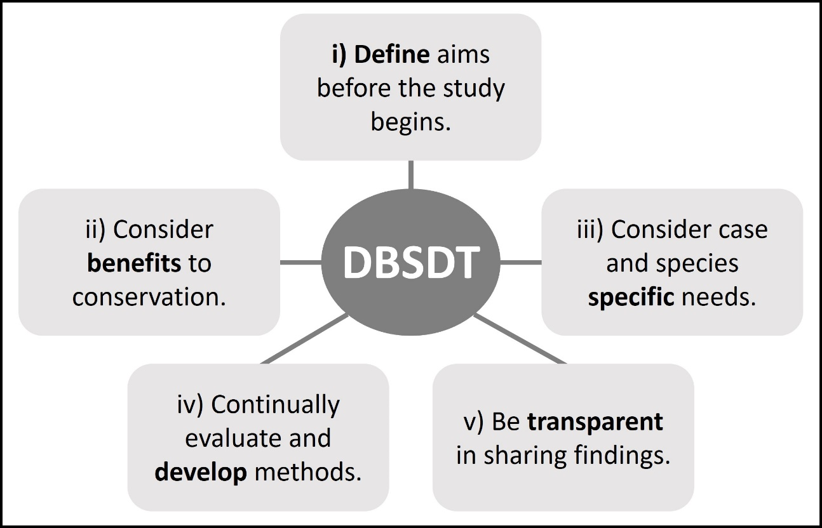
A framework for the ethical use of animal-borne devices in post- release monitoring following rehabilitation.
Harvey-Carroll et al., 2025

Slide 11
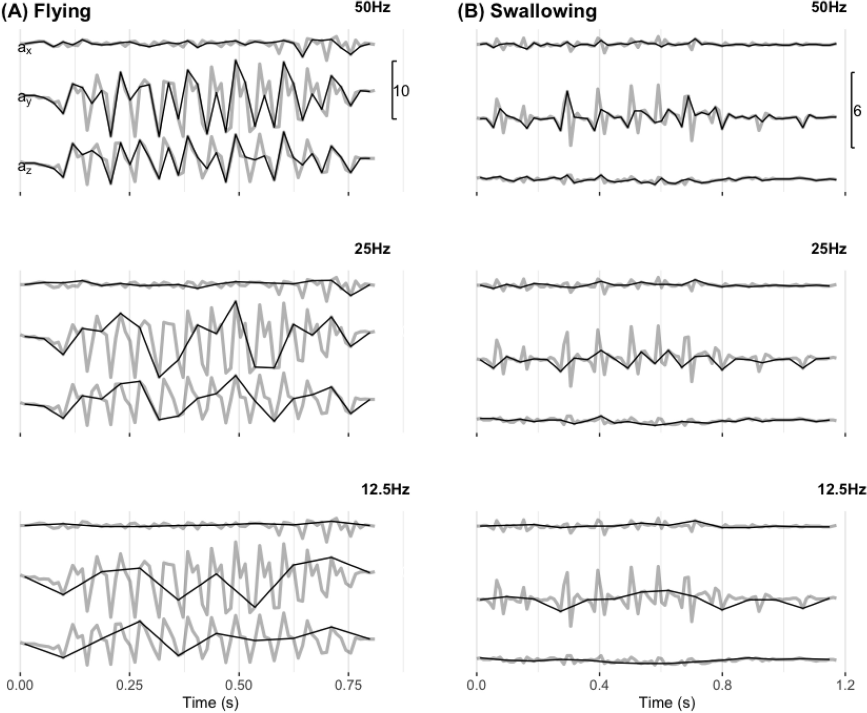
Requires validation
Decide the frequency of sampling usually 1-100Hz (Hz= readings/second)
Decide position
Decide attachment method
Smoothing window (depending on analysis)
Yu et al., 2023

Slide 12
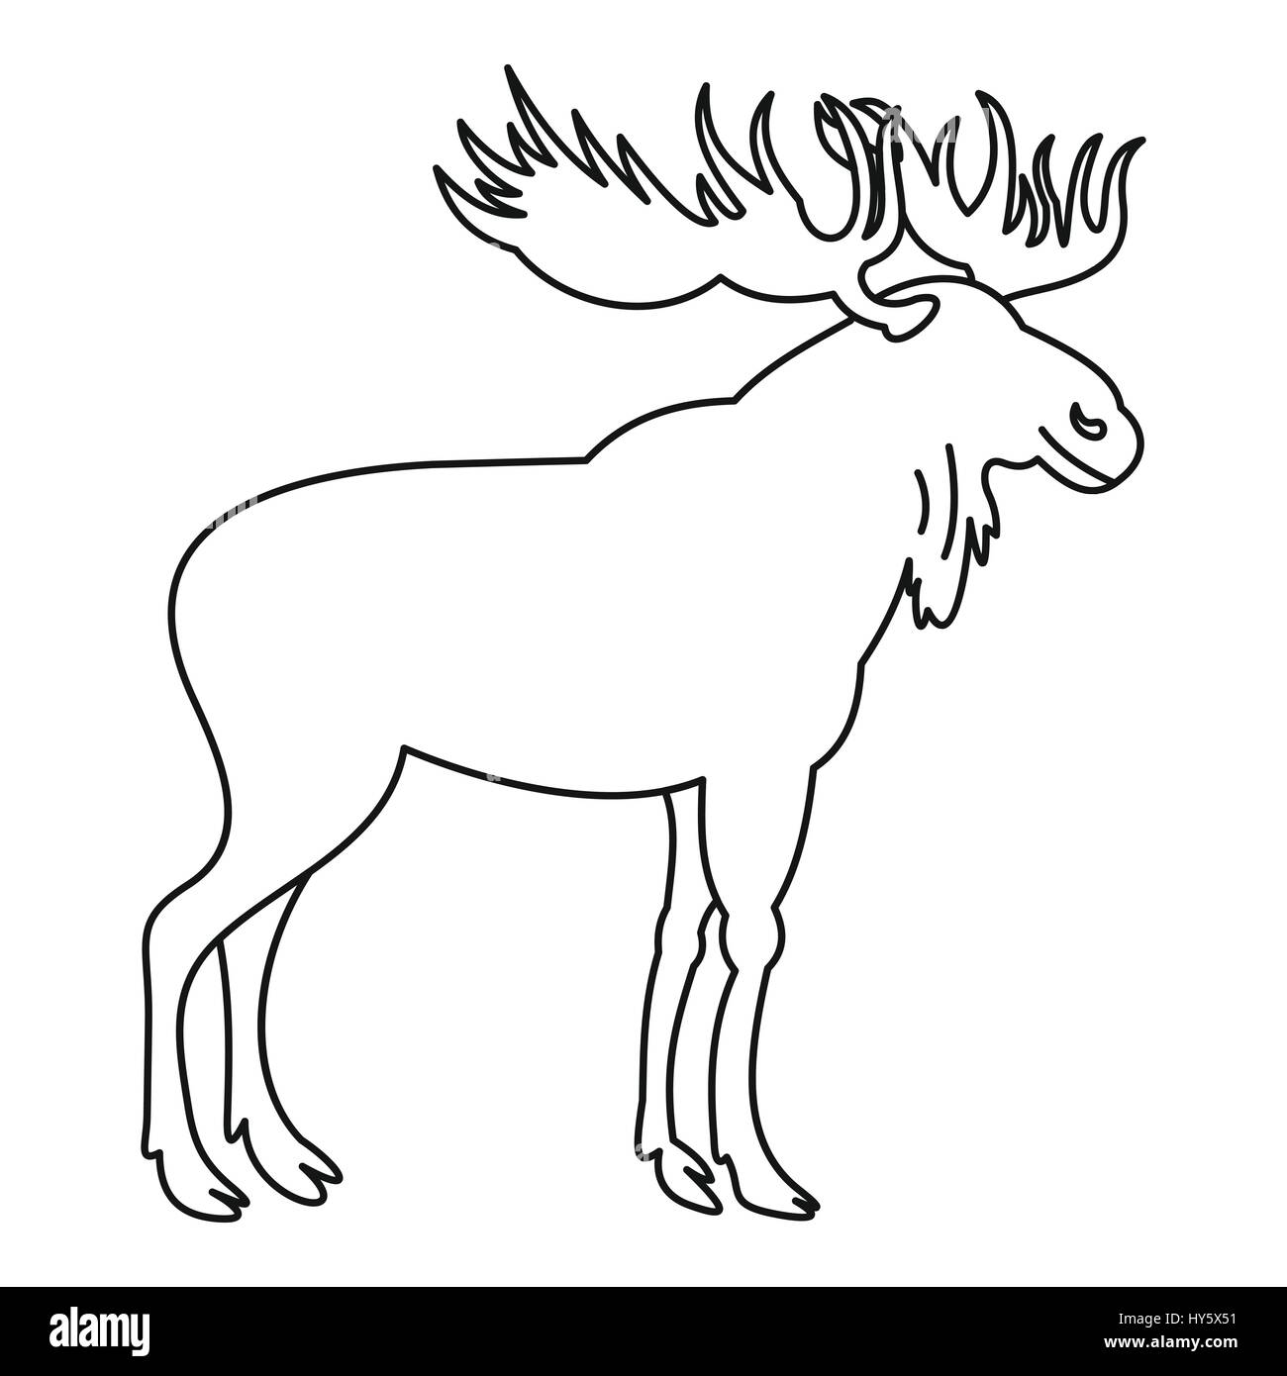
Decide the frequency of sampling usually 1-100Hz (Hz= readings/second)
Decide position
Decide attachment method
Smoothing window (depending on analysis)
Ear tag?
Collar?
Back?
Bracelet?

Slide 13
Attachment type. | Example taxa. | Limitation(s).
Ringing (e.g., leg or wing ringing). | Most birds. | May cause injury. Can increase drag during flight.
Ear tag. | Terrestrial mammals. | Can easily be lost, not suitable for large biologging devices.
Flipper tag. | Pinnipeds and chelonians. | Can increase the risk of entanglement.
Collar. | Terrestrial mammals. | Only suitable for large animals.
Adhesive (e.g., two component epoxy, super/ hot glue, Tesa tape). | Chelonians, birds, pinnipeds, Erinaceidae. | Falls off when fur or feathers are shed. Physically removed in the case of Erinaceidae. Can increase swimming drag.
Bolt. | Pangolins, chelonians, sharks. | Requires a hard structure. Risk of structural damage.
Internal (e.g., surgically inserted PIT tag). | A broad range of marine and terrestrial animals. | Invasive surgical procedure. Poorly researched impact on welfare.
Harness. | Birds, chelonians, pinnipeds. | Can cause irritation and injury particularly for growing animals.
Decide the frequency of sampling usually 1-100Hz (Hz= readings/second)
Decide position
Decide attachment method
Smoothing window (depending on analysis)
Harvey-Carroll et al., 2025

Slide 14


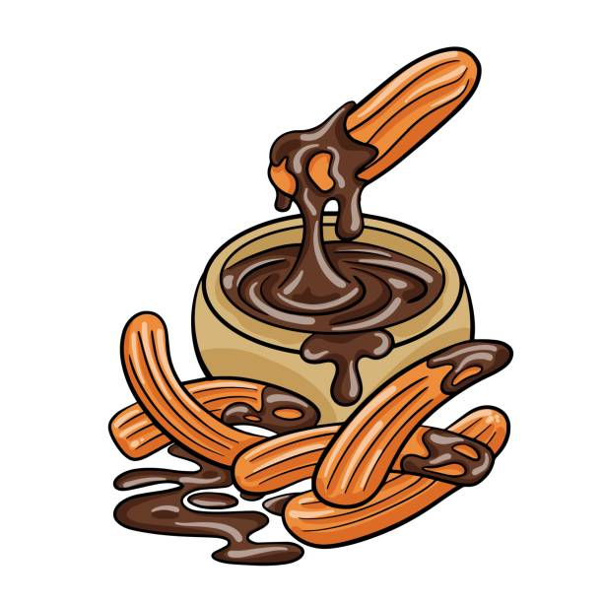
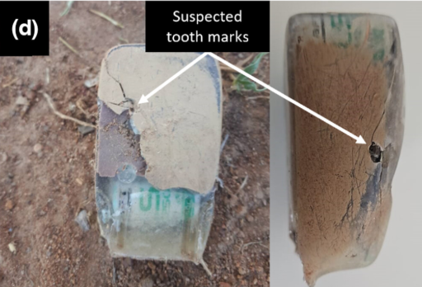
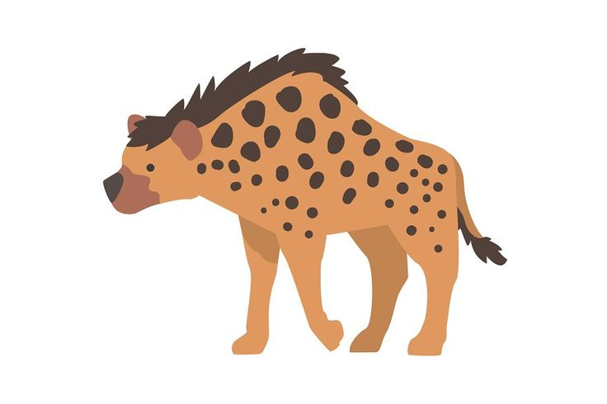
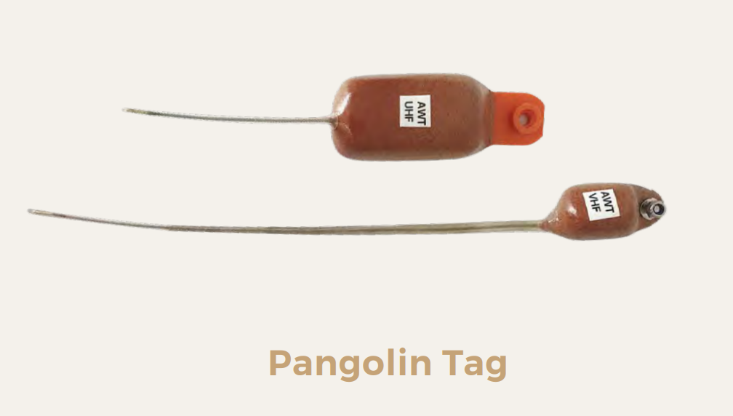
Predators like to eat telemetry devices like candy!
Carrol et al., 2024

Slide 15
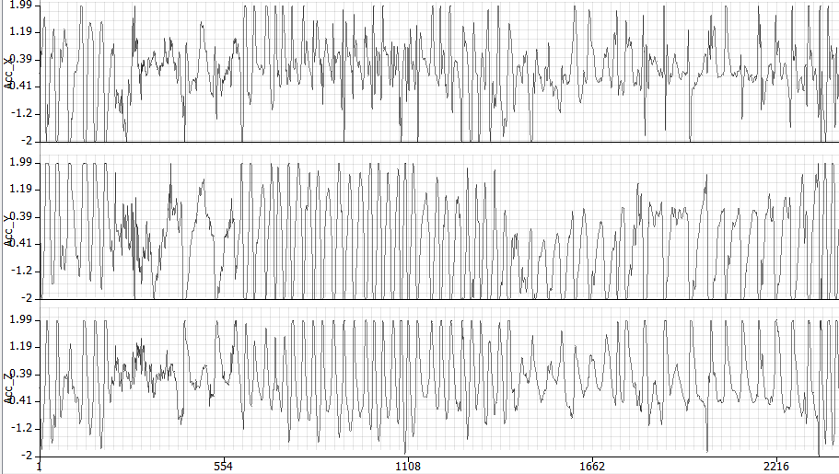
Decide the frequency of sampling usually 1-100Hz (Hz= readings/second)
Decide position
Decide attachment method
Smoothing window (depending on analysis)
Summary metrics
Machine learning

Slide 16
Decide the frequency of sampling usually 1-100Hz (Hz= readings/second)
Decide position
Decide attachment method
Smoothing window (depending on analysis)
Summary metrics
Machine learning

Slide 17
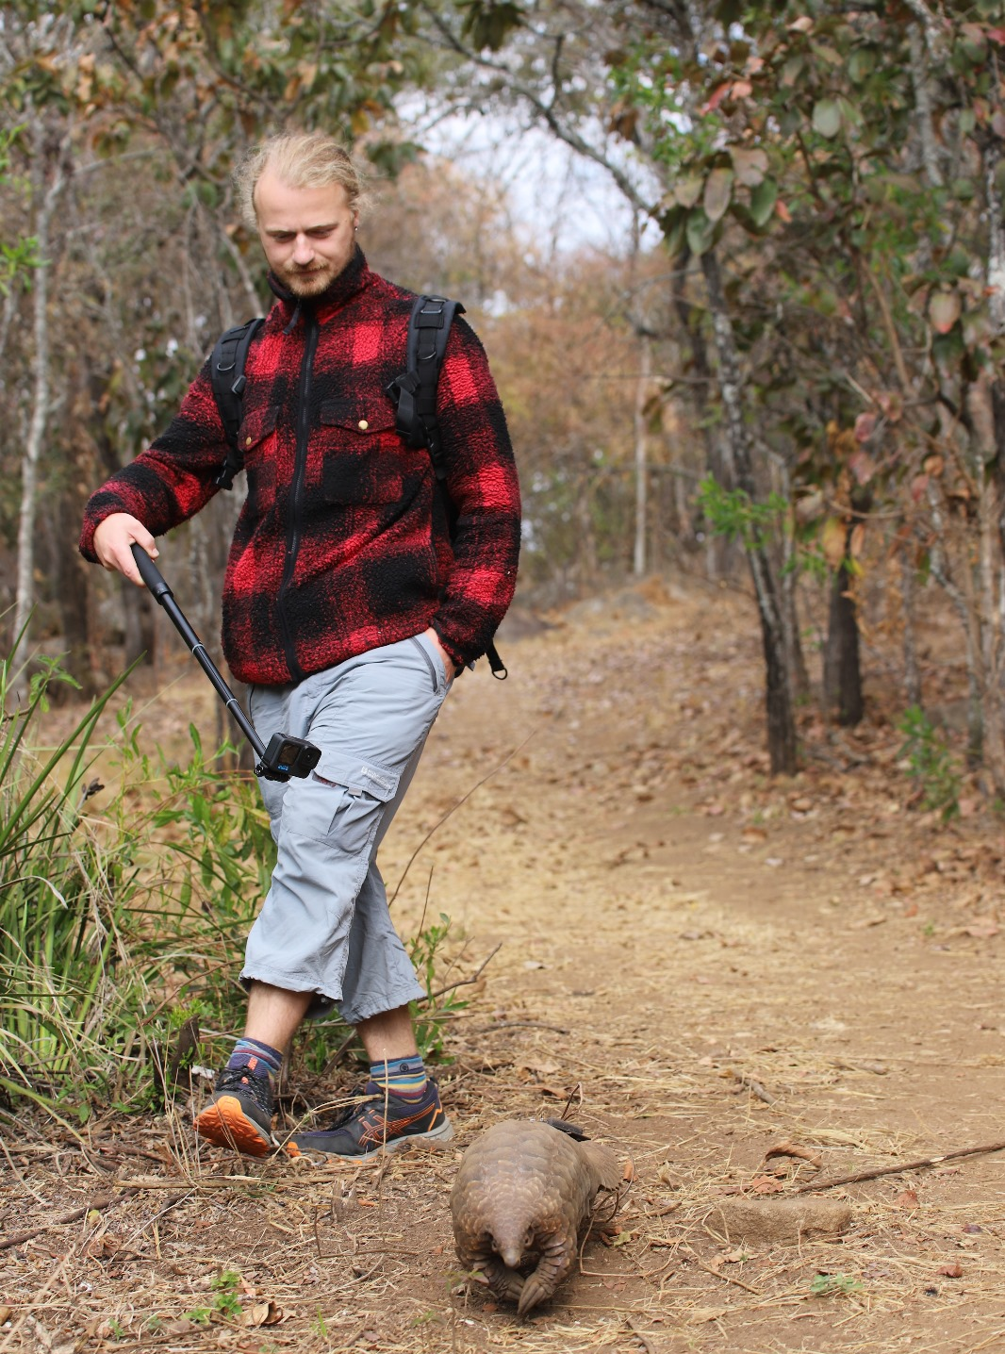
Ground truthing of accelerometer data
Matching ‘known’ behaviours to readouts
Produce model to then automatically label unknown data

Slide 18
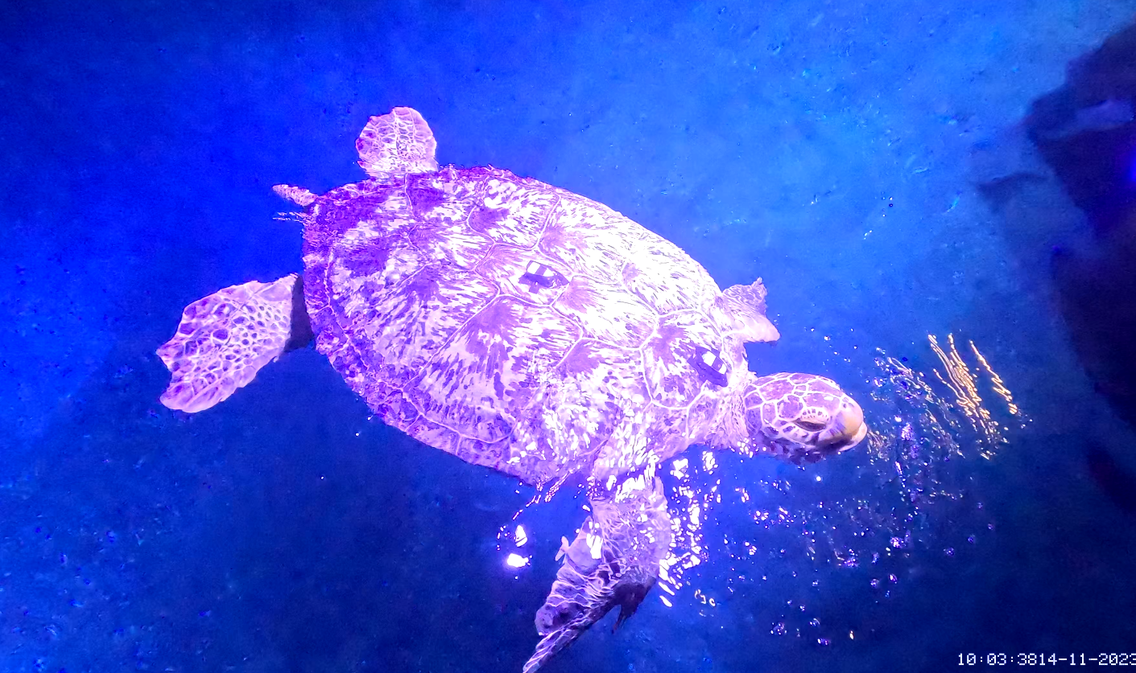
Accelerometer validation workflow
1.Collect videos (and GPS time)
2.Create ethograms in BORIS
3.Label accelerometer data (account for time synchronisation errors)
4.Test different window lengths
5.Subsample different frequencies
6.Calculate training metrics
7.Run cross-validation random forest

Slide 19
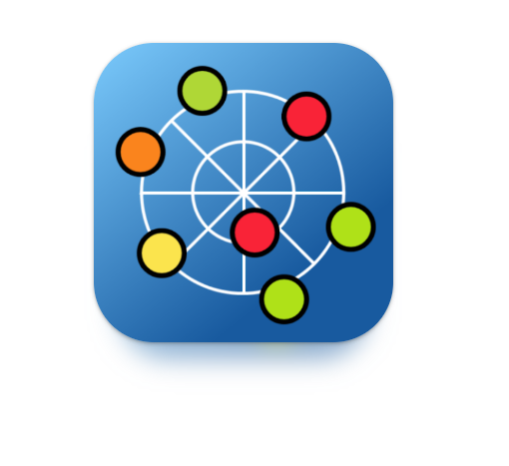
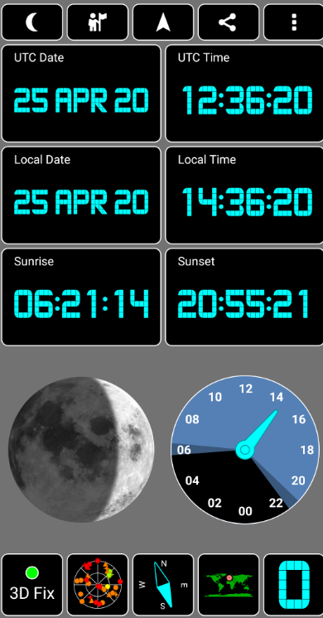
Time synchronisation- really important
When filming record UTC time for at least 5 seconds
Fix time difference between gopro time (if using labs) and video time (if using multiple videos)
Fix time difference between video and UTC
Trim second of start and finish of behaviours to improve precision

Slide 20
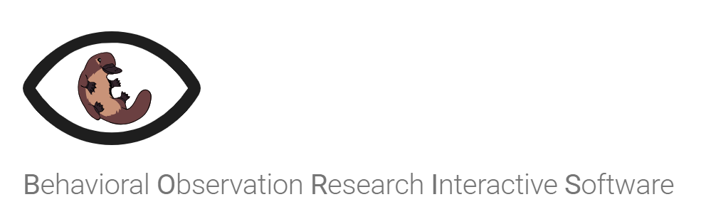
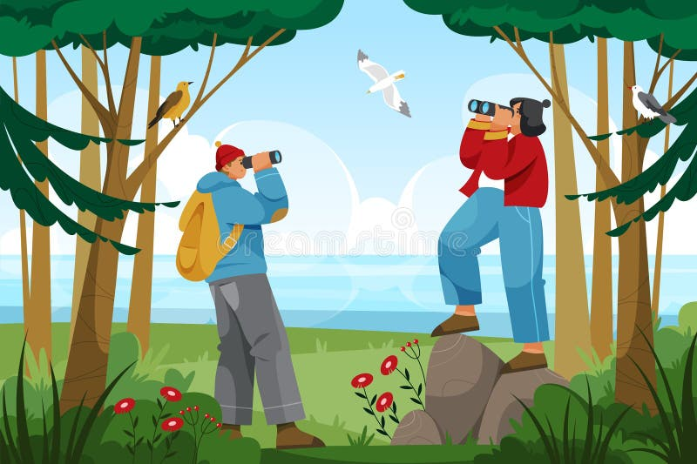
BORIS https://www.boris.unito.it/
The best software I have found! Aids reproducibility.
Create ethogram for multiple individuals simultaneously.
Can be used for live videos or recordings
Can have ethogram output in POSIXct or seconds (doesn’t matter, just changes code)
Behaviours can be state or points
I use point for time synchronisation and states for behaviours
Make sure to regularly save

Slide 21
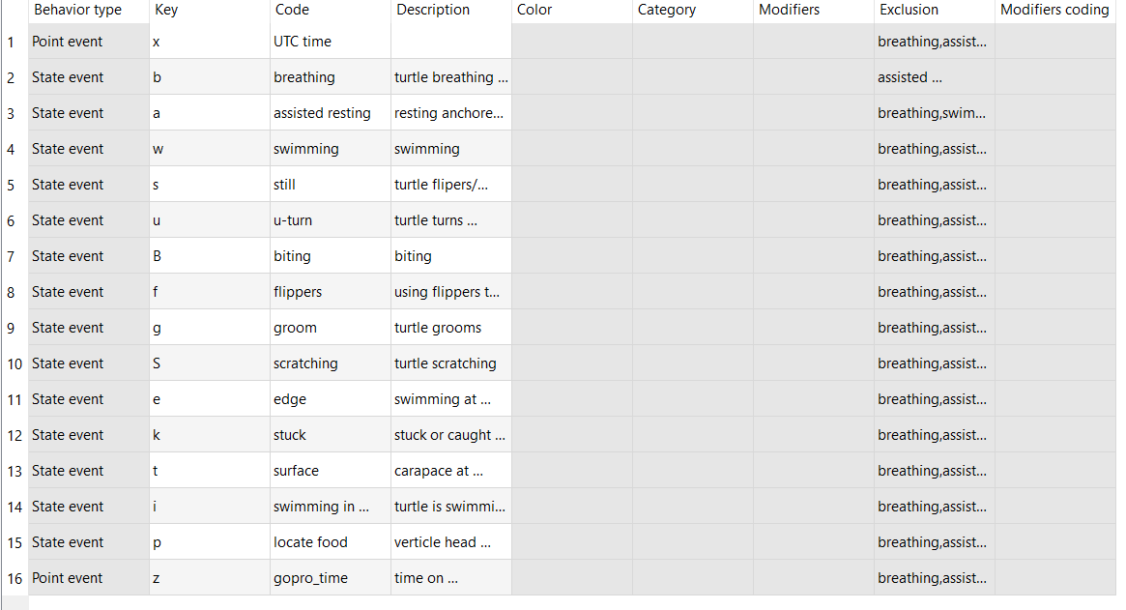
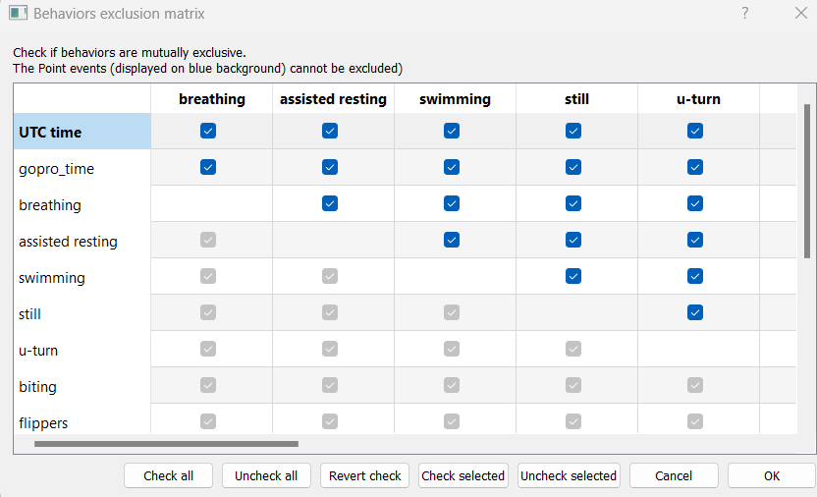
Ethograms
Exclusion matrix

Slide 22
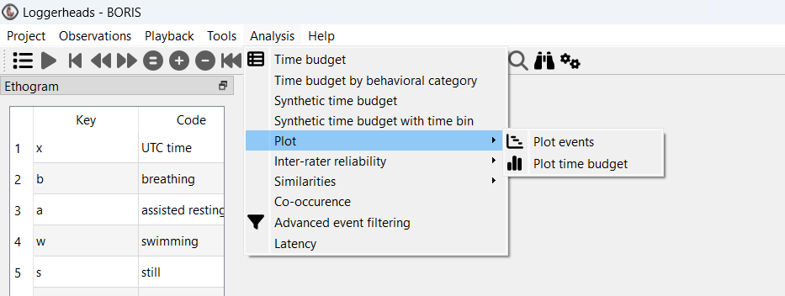
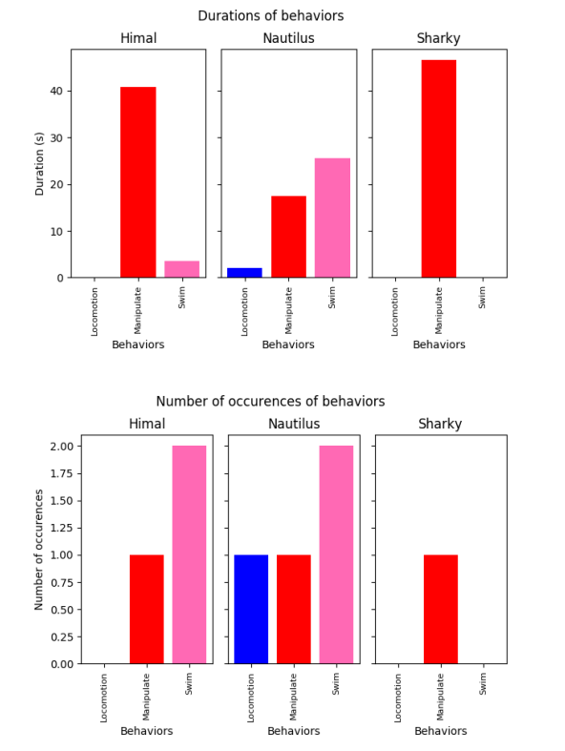
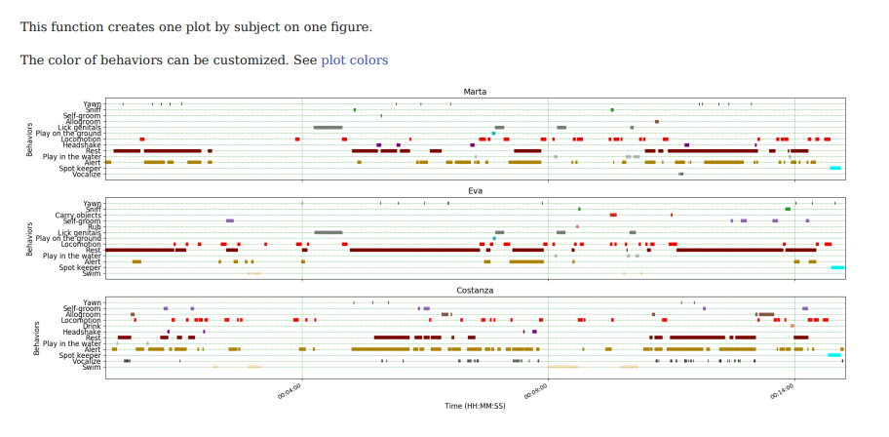
Quick analysis of data

Slide 23
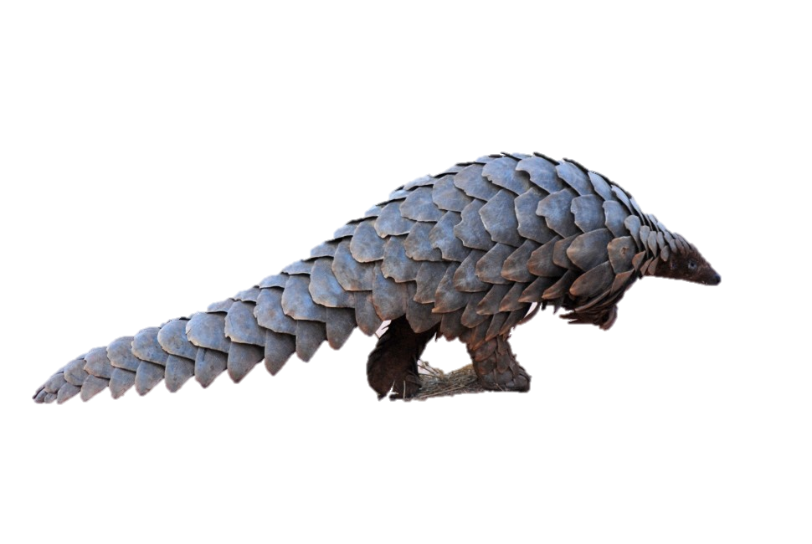
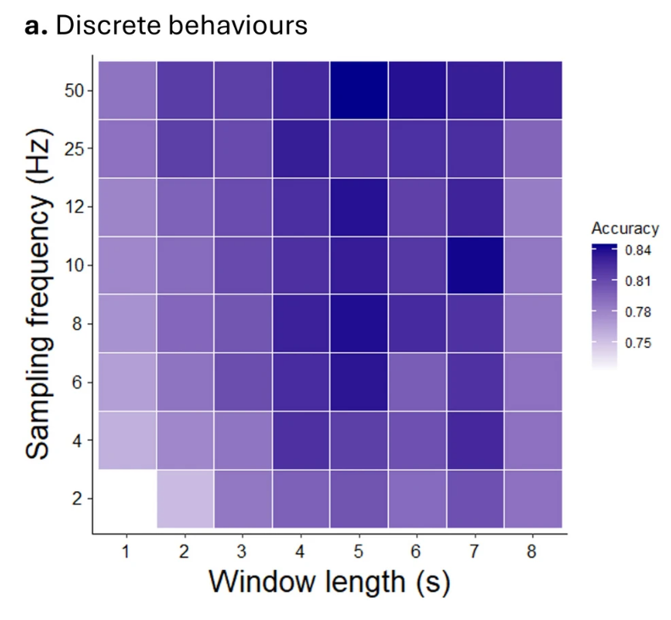
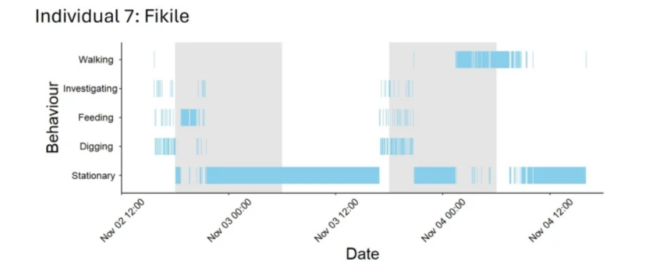
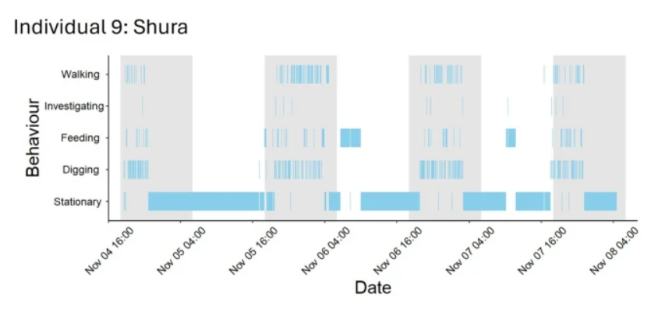
End result
Harvey-Carroll et al., 2024

